Slide 1
Food and Beverage Management fifth edition
Chapter 9
Appraising Performance

Slide 3
Chapter 9 covers:
Approaches to appraisal
Appraising revenue
Appraising costs
Appraising profits
Appraising the product

Slide 4
Performance appraisal
Revenue
Costs
Profits
The product

Slide 5
Fundamentals of appraisal
Knowing the goals and objectives
Placing a value on a measurement
Being prepared to make decisions

Slide 6
Basis of appraisal
Aims and objectives
Budgets
Standards

Slide 7
Performance against budget
Concept of variance calculation often misunderstood
Example:
Budget revenue of £300 and a budget cash gross profit of £195 (65%)
Actual revenue is £200 and the cash gross profit is £110 (55%)
Often wrongly reported as 10% drop in gross profit (65% less 55%)

Slide 8
Percentage variance on revenue
Is calculated as the difference between the actual cash revenue and the budget revenue, as a percentage of the budget revenue
Calculated as:
£200 – £300 ÷ £300 x 100
This equals –33.3%
There has been a 33.3% drop in revenue

Slide 9
Percentage variance on gross profit
Difference between the actual cash gross profit and the budgeted cash gross profit, as a percentage of the budgeted cash gross profit
Calculated as:
£110 – £195 ÷ £195 x 100
This equals – 43.5%
There has been a 43.5% drop in gross profit

Slide 10
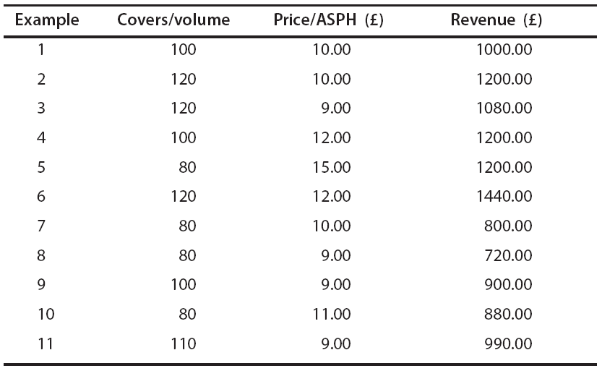
Changes in price and volume

Slide 11
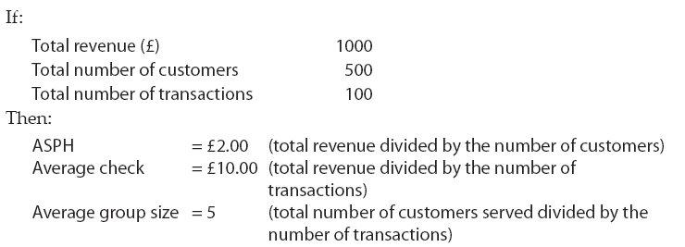
Spend per head and average check

Slide 12
Interpreting calculations
Price changes and inflation
Compare like with like
Comparison over time
Trends more clear with 12 month rolling totals
Averages can be very misleading
Other measures include:
Cross-sectional analysis
Time-series analysis

Slide 13
Key points of revenue appraisal
Revenue is product of price and volume
Appraisal needs to take account of changes in both price and volume
Averages not always accurate and prone to misinterpretation
Allow for inflation and/or price rises
Need to compare like with like
Incorporate 12-month rolling totals to determine true trends and performance
Revenue cannot be fully appraised by itself

Slide 14
Appraising costs
Fixed costs
Variable costs
Semi-variable costs

Slide 15
Identifying and measuring costs
Process needs to be objective
Can include:
Cross-sectional analysis
Relating one cost to another
Time series analysis

Slide 16
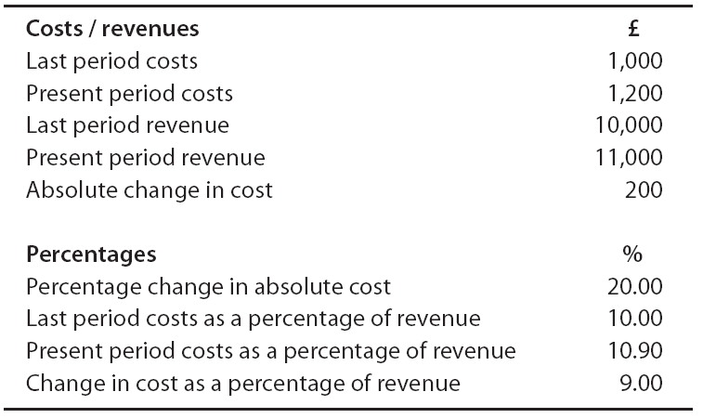
Change in costs and revenues

Slide 17
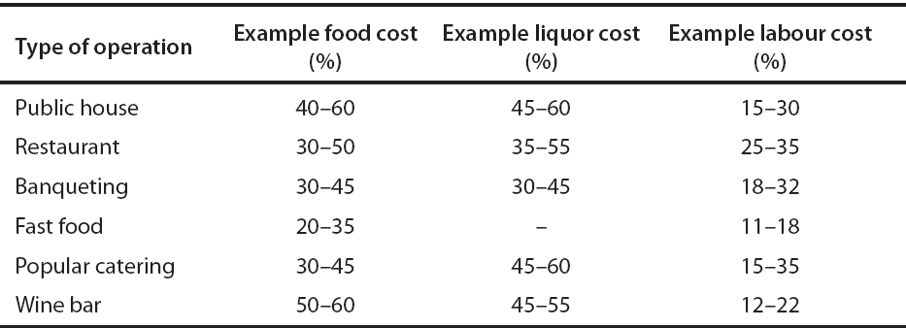
Industry norms for cost percentages

Slide 18
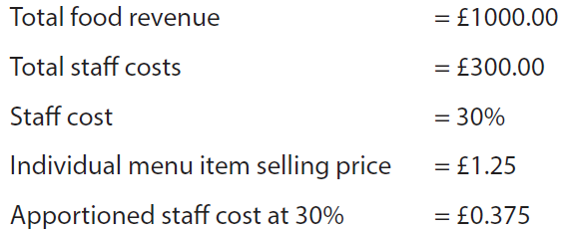
Apportioning direct costs

Slide 19
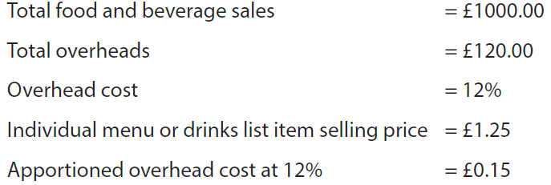
Apportioning indirect costs

Slide 20
Key points of cost appraisal
Structures vary, and change over time
Can be measured in cash or percentages but important to interpret them differently
Proportional relationship between costs
Relationship between costs and inflation
Cross-sectional and time-series analyses useful
12-month rolling totals identify true performance
Operators with the lowest costs perceived as having a key advantage
Allocating indirect costs more complex than allocating direct costs

Slide 21
Profitability measures
Gross profit
Operating profit
Net profit
Net operating profit
Departmental and unit profit
Yield

Slide 22
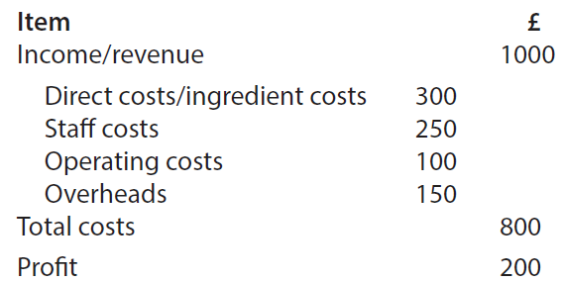
Example profit and loss account

Slide 23
Comparison of gross profits

Slide 24
Comparison of operating profits
* Costs will include ingredient costs and staff cost. The extent to which other costs have been included needs to be established

Slide 25
Yield comparisons

Slide 26
In food service operations
Revenue (or sales) is always identified as 100%
Gross profit is total sales less cost of sales
Net profit is revenue less cost of sales, labour costs and overheads
Percentages for costs and profits are always stated as a percentage of sales

Slide 27
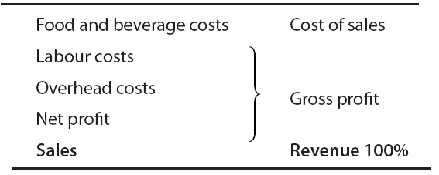
Relationship of revenue, costs and profits

Slide 28
GP in relation to revenue

Slide 29
Tyranny of gross profit percentages
GP% seen as measure of control
Achievement of GP% often seen as more valuable than revenue
Percentages are a measure of efficiency not profitability
Percentages cannot be banked!

Slide 30
Comparison of cash GP and GP %

Slide 31
Potential cash GP and GP %

Slide 32
Effect of changed sales mix

Slide 33
Sales mix example (beverages)

Slide 34
Example of profitability calculations

Slide 35
Popularity and profitability ranking

Slide 36
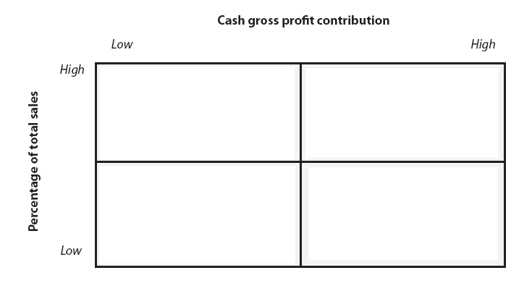
Menu engineering matrix
Adapted from Kasavana and Smith 1990

Slide 37
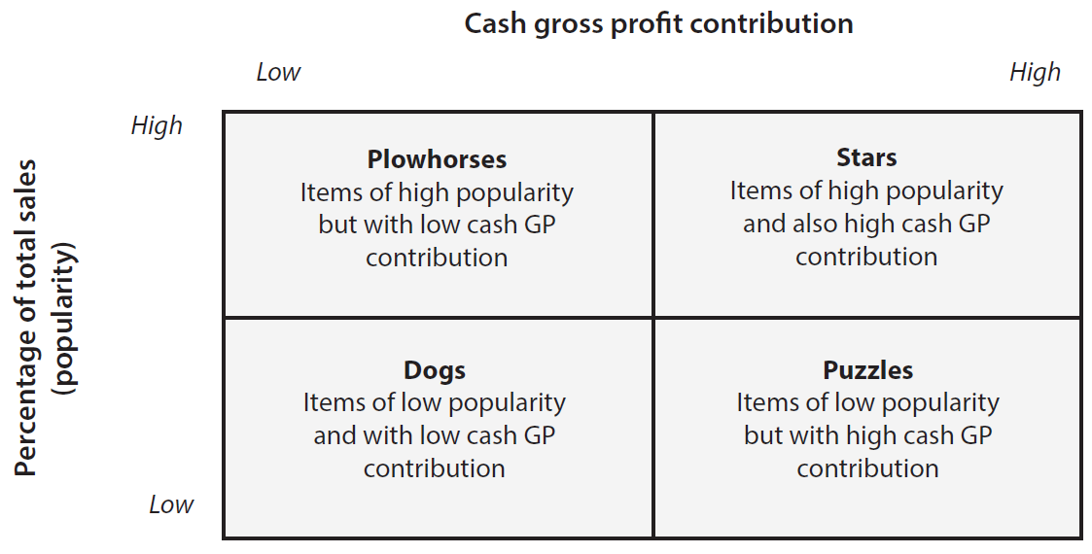
Menu engineering matrix
Adapted from Kasavana and Smith 1999

Slide 38
Helps to:
Plan for continuous control of cash GP
Identify and control the determinants of menu profitability
Treat different menu items uniquely
Can also be used for beverages and is the basis for yield management for rooms

Slide 39
Potential limitations
Elasticity of demand
Cost of labour
Shelf life
Fluctuations in demand

Slide 40
Comparison of net operating profit

Slide 41
Additional considerations:
Comparison with industry norms – but must compare like with like
The effects of inflation on prices
Stakeholder interests, including investors

Slide 42
Key points of profit appraisal
Be clear how profit measures are contrived
Compare like with like
Appraise against objectives to give value
Setting objectives includes subjective judgements
Sales mix analysis determines real trends
Profit percentages measure efficiency, not profitability
Cash contribution is what is being sought
Comparison with industry norms is valuable
Use rolling 12-month totals to indicate true performance
Take account of stakeholders’ priorities

Slide 43
Appraising the product
Approaches include:
Measuring customer satisfaction
Complaint monitoring
Staff focus groups
Mystery shopper
Process reviews
Quality audits
Quality standards analysis

Slide 44
Using the data generated
Outcomes are often presented in quantitative form
Better use of the data can provide more qualitative analysis and better understanding of the operation
Information can be generated on what is important to the customer, how the operation is achieving or capable of achiev­ing those things, and if the staff share the same view
Based on the ‘SERVQUAL’ approaches, the data can be appraised and extended into examples of useful comparison matrices

Slide 45
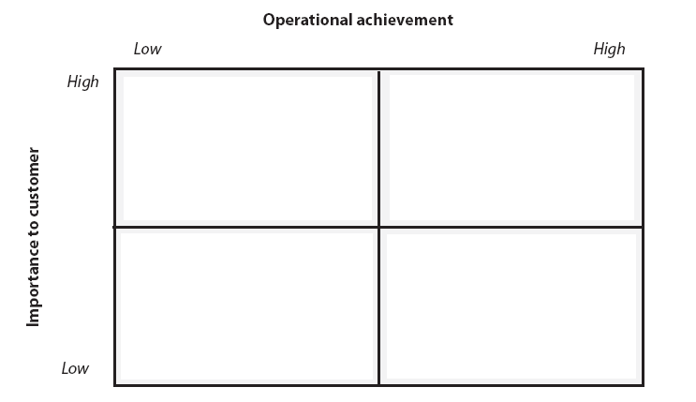
Customer importance / operational achievement matrix

Slide 46
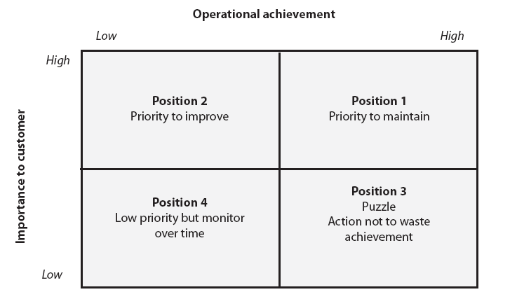
Customer importance / operational achievement matrix

Slide 47
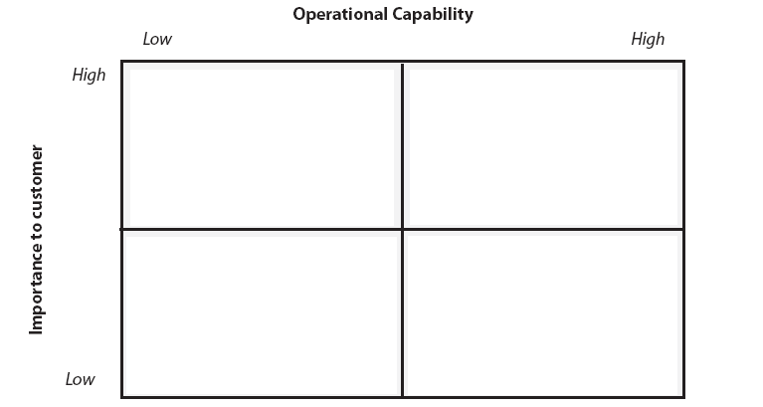
Customer importance / operational capability matrix

Slide 48
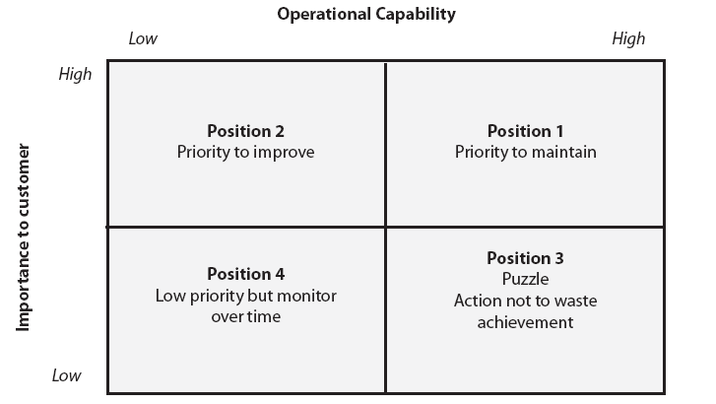
Customer importance / operational capability matrix

Slide 49
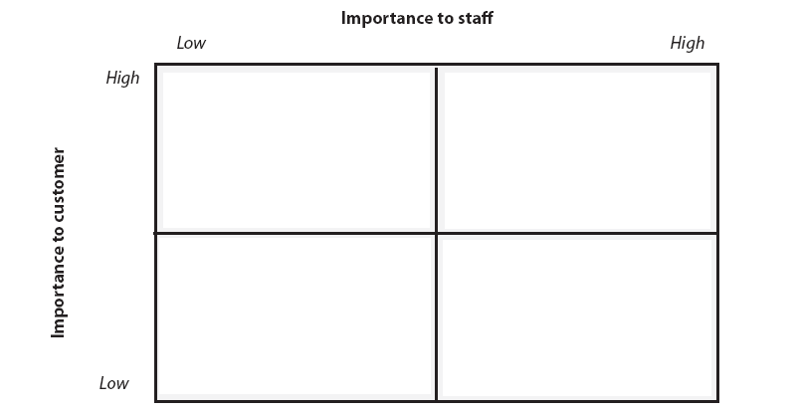
Customer importance / staff importance matrix

Slide 50
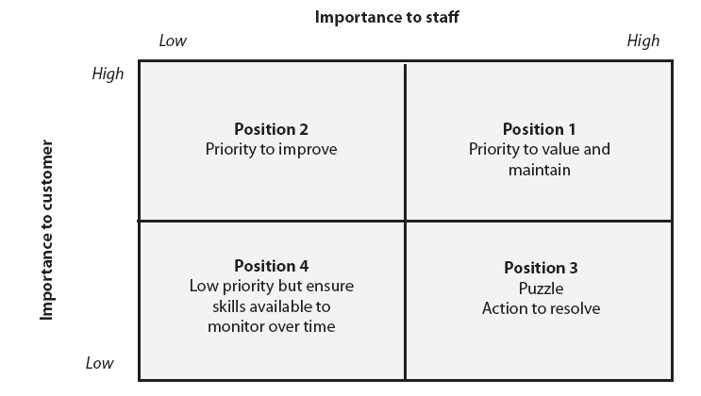
Customer importance / staff importance matrix

